Slide 1
Let Us Develop patience

Slide 2
introduction
Text: 2 Peter 1:5-7
In these verses “the Christian graces” are listed
According to vs. 5, we are to give all diligence in developing them
This morning we are concentrating on the 4th grace – “patience”

Slide 3
Let us first define patience
The bible contains several words that are translated “patience”
One word can also be translated “longsuffering”
This is the spirit we are to have while we go through periods of difficulty
This kind of “patience” is illustrated by the farmer (James 5:7)
We are to develop this kind of “patience” (James 5:8)
Another word can also be translated “endurance”, “steadfastness”, or “perseverance”
We develop this type of “patience” as a result of going through periods of difficulty (James 1:3-4)
This is the type of “patience” mentioned in 2 Peter 1:6

Slide 4
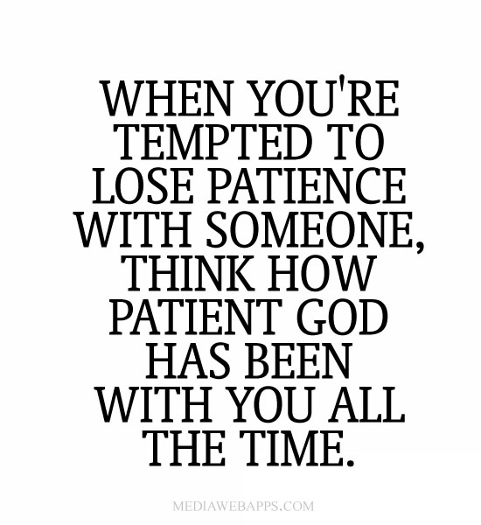

Slide 5
Why we must develop patience
We must develop “patience” because of what “impatience” will do to us.
“impatience will cause a person to quit or give up.
Jesus illustrated this point in His parable of the sower (matt. 13:20-21).
A person who quits following the Lord will lose his soul.
We must develop “patience” because the Bible teaches us to do so.
Luke 21:19; Rom. 12:12; 1 Thess. 5:14; Heb. 12:1
The Bible shows how “patience” will help us.
“patience” will help us in bearing fruit (luke 8:15; john 15:8)
“patience” will help us as we wait to receive God’s promise (heb. 10:36; 6:15)
“patience” will help us to avoid falling away (2 pet. 1:6, 8-10)
“patience” will help us when we pray (psalm 40:1)

Slide 7
How to develop patience
When we face trials, we must ask for wisdom (james 1:5-6).
We must develop the right kind of love because Christian love “endureth all things” (1 cor. 13:7)
We must look to the proper role models such as:
Christ (heb. 12:2-3)
The prophets (james 5:10)
Job (james 5:11)
We must learn to “wait upon the Lord” (isa. 40:28-31)

Slide 9
conclusion
Peter understood the importance of remembering to develop all of the Christian graces (2 peter 1:12, 15).
He was especially mindful of the need for “patience” (2 peter 1:13-14).
Just before he closed his letter Peter issued a strong warning that relates to “patience” (2 peter 3:17).
Developing “patience” is not easy, but the benefits and rewards are very special (2 peter 1:10-11; romans 8:18)

