Slide 1
Why attend every service?

Slide 2
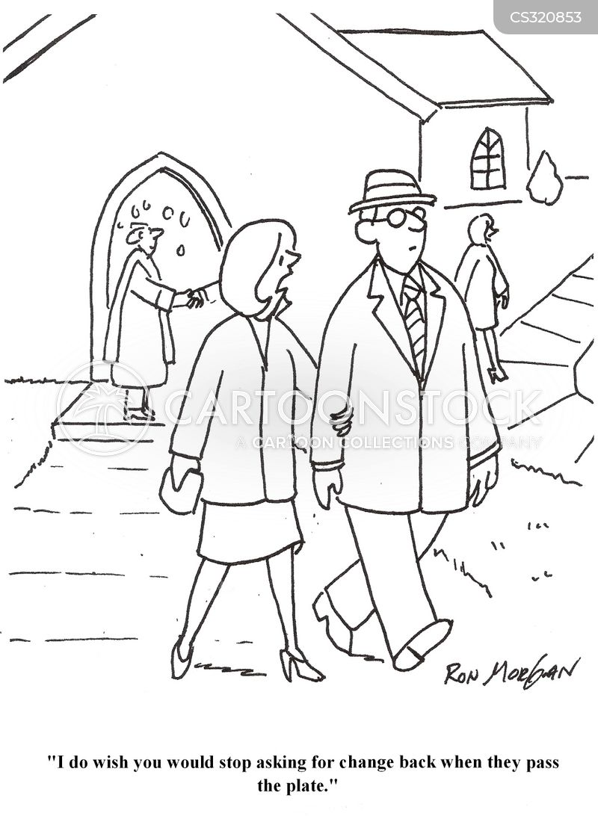

Slide 3
Introduction
In my life as a Christian, I have noticed the following in every church…
There are some Christians who attend every service of the church whenever possible…
There are other Christians whose attendance is infrequent…
Why the difference?
I am of the conviction that it makes a very real difference!

Slide 4
To fulfill the commands of god
The command not to forsake our assembling – Heb. 10:25
The command to edify one another – Rom. 14:19; 15:1-3; Heb. 3:12-14
The command to seek first the kingdom of God – Matt. 6:33; 10:37-38; Luke 14:26; Matt. 12:46-50

Slide 5
To grow and develop spiritually
The services are designed for spiritual growth – Heb. 5:12-14; Col. 3:16
Our growth is dependent upon our diet…

Slide 6
To help the church function properly
The local church needs workers – Eph. 4:15-16; 1Cor. 12:12-19
The church is dependent upon it’s members…

Slide 7
To provide a good example and influence
Christians are to set a good example – 1 Tim. 4:12; Tit. 2:7-8; Matt. 5:14-16; Phil. 2:15
Faithful attendance is essential for good influence – 1 Pet. 2:12

Slide 8
We must have the right attitude
A willingness to set spiritual priorities in seeking the Lord’s kingdom (church) “first” – Matt. 6:33
A desire to “deny self” and “follow Christ” – Matt. 16:24
A desire to display a “heart” of gratitude and gladness for the blessed priviledge of being able to “go into the house of the Lord” – Psalm 122:1

Slide 9
To have a clear conscience
A good conscience is important – Heb. 9:14; 1 Pet. 3:21; 1 Tim. 1:19; 1:5; Acts 24:16
Missing services contributes to a guilty conscience – 1 Tim. 4:2; Heb. 13:18

Slide 10
conclusion
Why attend every service? The faithful and fruitful child of God attends…
For such reasons (and many others), the faithful child of God will have the same attitude expressed by the sweet singer of Israel: Psalm 122:1

